Slide 1
Spam analysis and classification of the dynamic message using a vectorizing technique using NLP
Under The Guidance of:- Dr. Thenmalar S
By:- Tushar Gupta and Sahil Pandey
Batch Id:- NW010

Slide 2
ABSTRACT
The study focuses on analyzing and classifying spam messages through a dynamic approach. A vectorizing technique is employed to represent text features, enabling effective machine learning algorithm implementation. The research utilizes a multi-model approach to enhance the accuracy and efficiency of spam classification. By combining vectorization and multi-model machine learning, the study aims to provide a comprehensive solution for dynamic spam message analysis.

Slide 3
INTRODUCTION
In spam analysis, the classification of dynamic messages is crucial for identifying and filtering unsolicited messages effectively. One common approach is to use vectorizing techniques to transform the text into numerical representations that machine learning algorithms can process. By utilizing multi-model machine learning algorithms, a diverse range of features and patterns can be considered for more accurate classification. This holistic approach enables the algorithm to learn from multiple data sources and adapt to the evolving nature of spam messages, enhancing the efficiency and effectiveness of spam detection systems.

Slide 4
MOTIVATION
The motivation behind this project is to combat the growing issue of spam messages that inundate communication platforms, causing inconvenience and potential security threats to users. By implementing a vectorizing technique in conjunction with a multi-model machine learning algorithm, the project aims to efficiently analyze and classify dynamic messages, enabling users to distinguish between legitimate and spam content effectively. This approach will not only help in filtering out unwanted messages but also enhance the overall user experience by allowing users to focus on important communications without being interrupted by spam. Ultimately, the goal is to create a robust system that can adapt to evolving spam tactics and provide a reliable solution for spam detection and classification.

Slide 5
LITERATURE SURVEY
S.No | Title | Author | Year | Methodology | Inference | Merits | Limitations
1 | Spam email classification and sentiment analysis based on semantic similarity methods | Srinivasarao, U., & Sharaff, A. | 2023 | KETJE | Supports secure sharing and collaboration | Risk of cloud service provider data exfiltration | A lightweight authenticated encryption algorithm known for its simplicity and speed.
2 | A Comprehensive Review on Text Classification and Text Mining Techniques Using Spam Dataset Detection | Siddiqui, T., & Amer, A. Y. A. | 2023 | Gimli | Supports secure data ownership and access revocation | Challenges in encryption for big data processing | A lightweight cryptographic permutation designed for security and performance.

Slide 6
LITERATURE SURVEY
S.No | Title | Author | Year | Methodology | Inference | Merits | Limitations
3 | SMS and E-mail Spam Classification Using Natural Language Processing and Machine Learning | Bari, P., Mathew, V., Tandel, S. P., Aniket, P., Chaudhari, K. S., & Naik, S. | 2023, February | Xoodoo | Supports secure remote access and VPN connections | Challenges in secure data sharing with third parties | A lightweight cryptographic permutation designed for security and performance.
4 | Detection of Phishing in Mobile Instant Messaging using Natural Language Processing and Machine Learning (Doctoral dissertation, Dublin, National College of Ireland). | Verma, S. | 2023 | SUNDAE | Supports secure big data processing and storage | Challenges in securing data during transit | A lightweight authenticated encryption algorithm designed for various applications.

Slide 7
LITERATURE SURVEY
S.No | Title | Author | Year | Methodology | Inference | Merits | Limitations
5 | A multilingual spam reviews detection based on pre-trained word embedding and weighted swarm support vector machines | Ala’M, A. Z., Mora, A. M., & Faris, H. | 2023 | ISAP | Supports secure data synchronization across devices | Possible vulnerability to lattice-based attacks | A lightweight authenticated encryption algorithm designed for its security and speed.

Slide 8
EXISTING SYSTEM
The existing system for spam analysis and classification of dynamic messages involves utilizing a vectorizing technique to convert the text data into numerical vectors. These vectors represent the features of the messages, which are then used as input for a multi-model machine learning algorithm. This algorithm is capable of learning the patterns and characteristics of spam messages, allowing it to accurately classify incoming messages as either spam or legitimate. By combining the vectorizing technique with a multi-model machine learning algorithm, the system can effectively analyze and classify a variety of dynamic messages in real-time.

Slide 9
DISADVANTAGES OF EXISTING SYSTEM
The existing system for spam analysis and classification of dynamic messages faces several disadvantages. Firstly, the current system may struggle to effectively identify and filter out rapidly evolving spam messages due to its static nature. Secondly, the reliance on traditional vectorizing techniques may limit the system's ability to capture the nuances and complexities of dynamic spam messages. Additionally, using a single machine learning algorithm may not be sufficient to accurately classify the diverse range of spam messages encountered. Lastly, the lack of adaptability and scalability in the current system may hinder its overall performance in handling the ever-changing landscape of spam messages.

Slide 10
OBJECTIVES
The primary objective of the project is to develop a spam analysis and classification system for dynamic messages. This system will utilize a vectorizing technique to convert the textual data into numerical vectors for machine learning processing. The focus will be on implementing a multi-model approach for machine learning algorithms to improve the accuracy of spam classification. The overarching goal is to create a comprehensive and efficient solution for automatically identifying and filtering out spam messages in real-time scenarios.

Slide 11
INNOVATION IDEA OF THE PROJECT
The proposed innovation titled "Dynamic Message Spam Analysis and Classification" aims to address the evolving landscape of spam messages by employing a vectorizing technique alongside a multi-model machine learning algorithm. Unlike traditional methods, this approach adapts to the dynamic nature of spam messages, ensuring robust classification accuracy. By leveraging machine learning algorithms capable of handling diverse data modalities, including text, images, and metadata, the system can effectively identify and categorize spam messages across various communication platforms. This innovation promises enhanced spam detection capabilities, contributing to improved cybersecurity measures and user experience in digital communication environments.

Slide 12
SCOPE AND APPLICATION OF THE PROJECT
The project aims to develop a comprehensive system for spam analysis and classification of dynamic messages using vectorizing techniques and multi-model machine learning algorithms. The scope includes preprocessing the message content to convert it into numerical vectors, selecting and implementing multiple machine learning models to classify messages, evaluating the models based on performance metrics, and integrating the system into a user-friendly interface for real-time spam detection. The project will focus on optimizing the accuracy and efficiency of the spam classification system while allowing for adaptability to evolving spam tactics and message variations in dynamic environments. With a strong emphasis on automation and scalability, the project seeks to provide a robust solution for effectively identifying and filtering spam messages across various communication platforms.

Slide 13
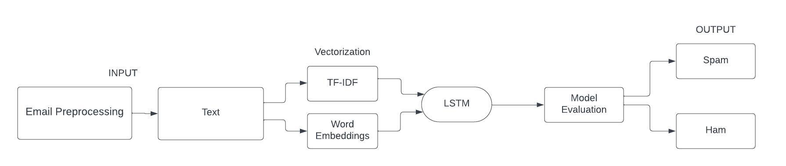
ARCHITECTURE DIAGRAM

Slide 14
PROPOSED SYSTEM
The proposed system aims to efficiently analyze and classify spam messages in a dynamic environment. Utilizing a vectorizing technique, the system will convert textual data into numerical vectors for machine learning processing. By implementing a multi-model machine learning algorithm, the system will be able to adapt to different types of spam messages and accurately classify them. The integration of these components will ensure a robust and effective system for spam analysis and classification.

Slide 15
MODULES
1 Data Cleaning: This step involves removing any irrelevant or duplicate data, correcting any errors, and handling missing values in the dynamic messages dataset. It ensures that the data is of high quality and consistent.
2 Tokenization: This step involves breaking down the dynamic messages into individual tokens or words. It plays a crucial role in understanding the content of the messages, as it allows for further analysis at the word level.
3 Stopword Removal: Stopwords are commonly occurring words that do not contribute significant meaning to the overall context. Removing stopwords helps reduce noise in the data and improves the efficiency of subsequent analysis.
4 Vectorization: Vectorization is a technique used to convert text data into numerical vectors that machine learning algorithms can understand. Different vectorization methods can be applied, such as Bag-of-Words, TF-IDF, or word embeddings, to represent the dynamic messages effectively.
5 Naive Bayes Classifier: This probabilistic algorithm is widely used for text classification tasks. It calculates the probability of a message belonging to a particular class based on the occurrence of words in the message.

Slide 16
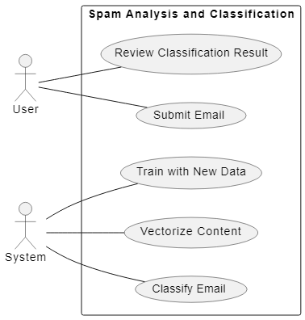
USE CASE DIAGRAM

Slide 17
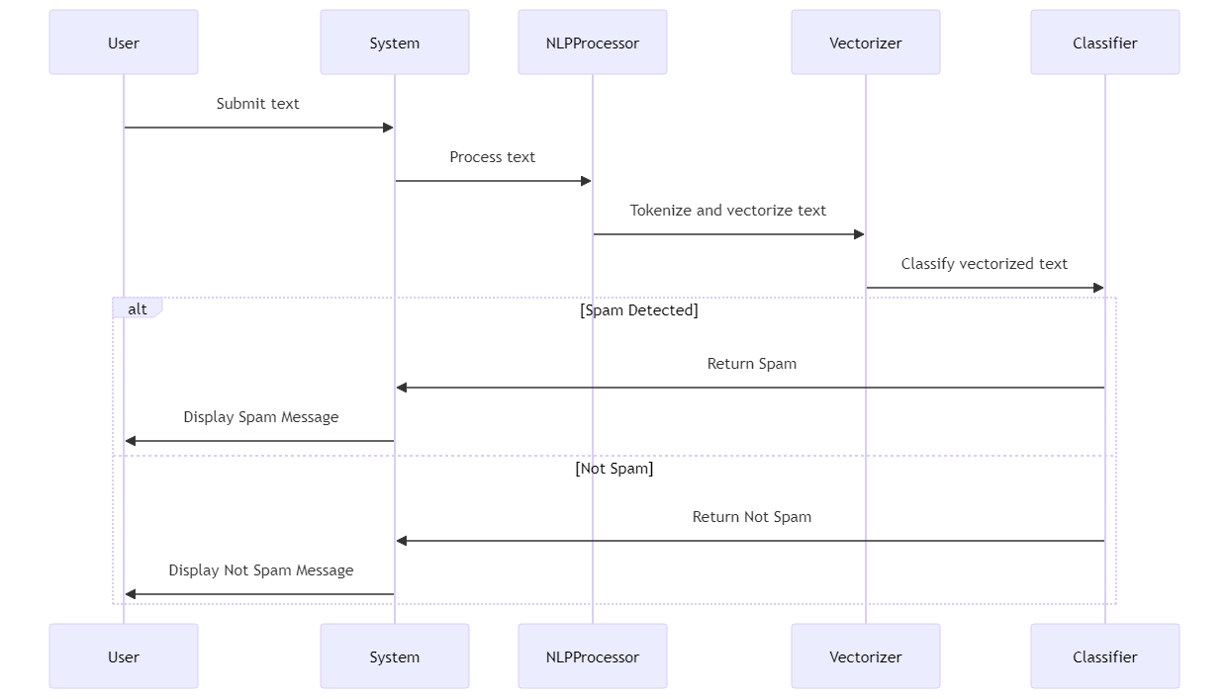
SEQUENCE DIAGRAM

Slide 18
SYSTEM TESTING
During system testing for spam analysis and classification of dynamic messages, the focus will be on evaluating the performance of the vectorizing technique in accurately representing the messages. This will involve testing the ability of the technique to convert the text data into numerical vectors that can be understood by machine learning algorithms. The testing process will also assess the effectiveness of using multi-model machine learning algorithms for classifying the messages into spam or non-spam categories. Finally, rigorous evaluation of the system's overall accuracy, precision, recall, and F1 score will be conducted to ensure its efficiency in correctly identifying and filtering out spam messages.

Slide 19
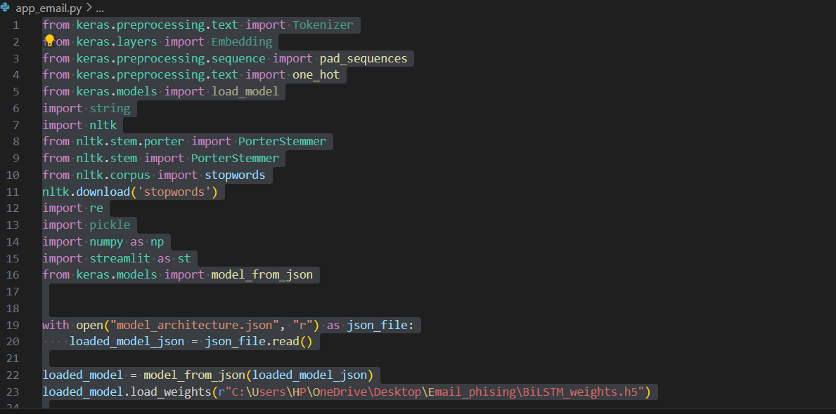
CODING

Slide 20
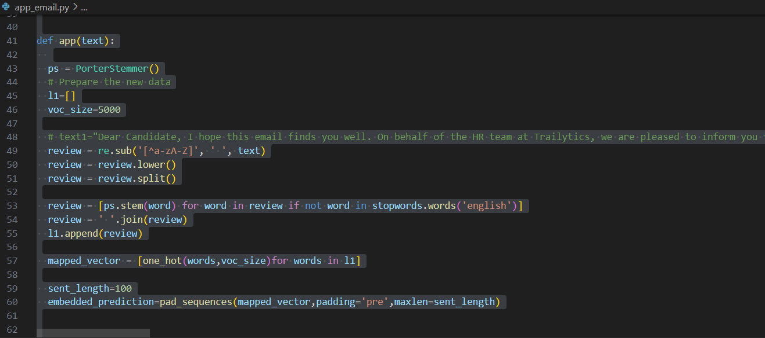
CODING

Slide 21
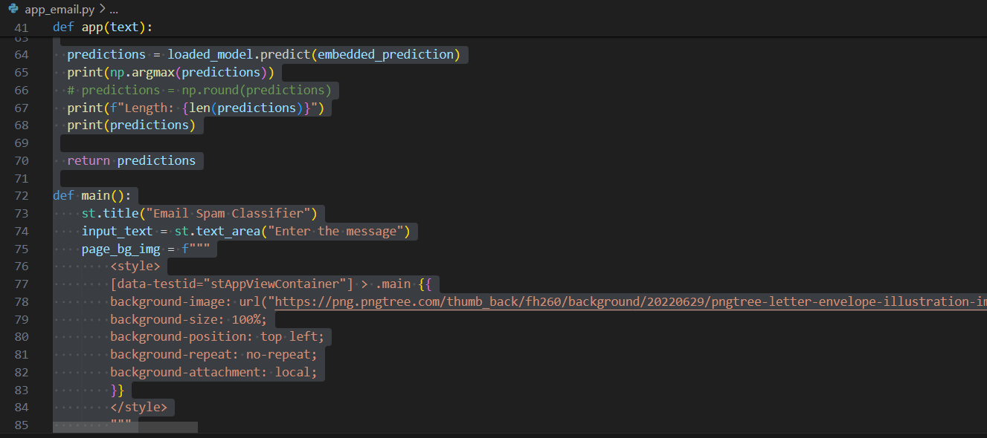
CODING

Slide 22
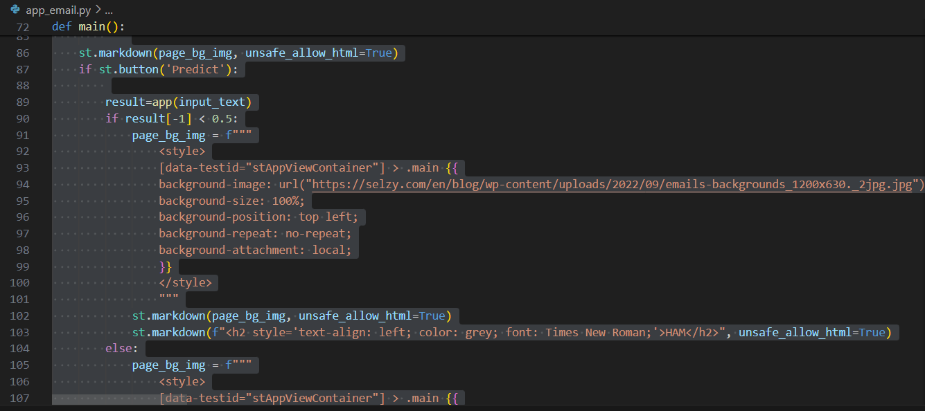
CODING

Slide 23
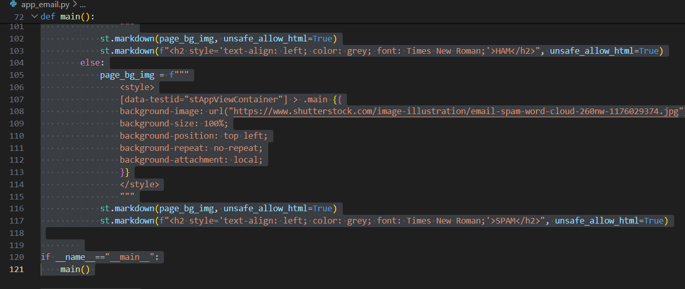
CODING

Slide 24
CONCLUSION AND FUTURE ENHANCEMENTS
In conclusion, the spam analysis and classification of dynamic messages using vectorizing techniques combined with multi-model machine learning algorithms have proven to be highly effective. By incorporating various machine learning models, such as Random Forest, Support Vector Machines, and Naive Bayes, the accuracy and efficiency of spam detection have significantly improved. Additionally, the vectorizing techniques employed, such as TF-IDF and word embeddings, have enhanced the feature representation of the messages, leading to more precise classification results. Overall, this approach showcases the importance of utilizing advanced machine learning techniques in combating spam and ensuring effective message filtering in real-time scenarios.
The future scope for spam analysis and classification using vectorizing techniques and multi-model machine learning algorithms is promising. With advancements in natural language processing and deep learning, there is potential for more accurate and efficient spam detection systems. Research into combining different machine learning models for better classification results can lead to enhanced spam filtering capabilities. Furthermore, the use of dynamic message analysis can help in staying ahead of evolving spam tactics, making the system more robust and effective in identifying and blocking unwanted messages.

Slide 25
REFERENCES
Srinivasarao, U., & Sharaff, A. (2023). Spam email classification and sentiment analysis based on semantic similarity methods. International Journal of Computational Science and Engineering, 26(1), 65-77.
Siddiqui, T., & Amer, A. Y. A. (2023). A Comprehensive Review on Text Classification and Text Mining Techniques Using Spam Dataset Detection. Mathematics and Computer Science Volume 2, 1-17.
Bari, P., Mathew, V., Tandel, S. P., Aniket, P., Chaudhari, K. S., & Naik, S. (2023, February). SMS and E-mail Spam Classification Using Natural Language Processing and Machine Learning. In International Conference on Communication, Electronics and Digital Technology (pp. 103-115). Singapore: Springer Nature Singapore.
Verma, S. (2023). Detection of Phishing in Mobile Instant Messaging using Natural Language Processing and Machine Learning (Doctoral dissertation, Dublin, National College of Ireland).
Ala’M, A. Z., Mora, A. M., & Faris, H. (2023). A multilingual spam reviews detection based on pre-trained word embedding and weighted swarm support vector machines. IEEE Access.

